Slide 1
Greedy Algorithms

Slide 2
Introduction
An activity-selection problem
Greedy Algorithm
Optimal loading problem
Shortest path problem
Minimal spanning tree

Slide 3

What’s greedy algorithm
Suppose there are 4 kinds of coins: 20 cents, 10 cents, 5 cents and 1 cent.
Will give changes of 53 cents for customer
Usually we sort the coins increasingly
two 20 cents coins, one 10 cents and three 1 cent.
It is greedy algorithm

Slide 4
If the coins are 11 cents, 7 cents, 5 cents and 1 cent.
Give change 26 cents.
If use greedy algorithm, the solution will be: two 11 cents, four 1 cent, 6 coins totally.
But we can use one 11 cents and three 5 cents. Totally 4 coins.
So local optimal selection can not get global optimal selection

Slide 5
A greedy algorithm always makes the choice that looks best at the moment. That is, it makes a locally optimal choice in the hope that this choice will lead to a globally optimal solution
Greedy algorithms do not always yield optimal solutions

Slide 6
An activity-selection problem
Suppose we have a set S = {a₁, a₂, ..., a_{n}} of n proposed activities that wish to use a resource, such as a lecture hall, which can be used by only one activity at a time.
Each activity a_{i} has a start time s_{i} and a finish time f_{i}, where 0 ≤ s_{i} < f_{i} < ∞. If selected, activity a_{i} takes place during the half-open time interval [s_{i}, f_{i}).
Activities a_{i} and a_{j} are compatible (相容的)if the intervals [s_{i}, f_{i}) and [s_{j} f_{j}) do not overlap
The activity-selection problem is to select a maximum-size subset of mutually compatible activities.

Slide 7
The optimal substructure of the activity-selection problem
we start by developing a dynamic-programming solution to the activity-selection problem.
S_{ij} = {a_{k} ∈ S : f_{i} ≤ s_{k} < f_{k} ≤ s_{j}} ,

Slide 8
consider the following set S of activities, which we have sorted in monotonically increasing order of finish time:
k | 1 | 2 | 3 | 4 | 5 | 6 | 7 | 8 | 9 | 10 | 11
s[k] | 8 | 3 | 3 | 5 | 0 | 5 | 12 | 8 | 1 | 2 | 6
f[k] | 12 | 5 | 8 | 7 | 6 | 9 | 14 | 11 | 4 | 13 | 10

Slide 9
consider the following set S of activities, which we have sorted in monotonically increasing order of finish time:
the subset {a₃, a₉, a₁₁} consists of mutually compatible activities.
{a₁, a₄, a₈, a₁₁} is the largest subset of compatible activities
another largest subset is {a₂, a₄, a₉, a₁₁}.
i | 1 | 2 | 3 | 4 | 5 | 6 | 7 | 8 | 9 | 10 | 11
s_{i} | 1 | 3 | 0 | 5 | 3 | 5 | 6 | 8 | 8 | 2 | 12
f_{i} | 4 | 5 | 6 | 7 | 8 | 9 | 10 | 11 | 12 | 13 | 14

Slide 10
The optimal substructure of the activity-selection problem
we need to define an appropriate space of subproblems. Let us start by defining sets
S_{ij} = {a_{k} ∈ S : f_{i} ≤ s_{k} < f_{k} ≤ s_{j}}
S_{ij} is the subset of activities in S that can start after activity a_{i} finishes and finish before activity a_{j} starts.
In fact, S_{ij} consists of all activities that are compatible with a_{i} and a_{j} and are also compatible with all activities that finish no later than a_{i} finishes and all activities that start no earlier than a_{j} starts.

Slide 11
The optimal substructure of the activity-selection problem
suppose that a solution to S_{ij} includes some activity a_{k}, so that f_{i} ≤ s_{k} < f_{k} ≤ s_{j}. Using activity a_{k} generates two subproblems, S_{ik} (activities that start after a_{i} finishes and finish before a_{k} starts) and S_{kj} (activities that start after a_{k} finishes and finish before a_{j} starts), each of which consists of a subset of the activities in S_{ij}.

Slide 12
The optimal substructure
Suppose now that an optimal solution A_{ij} to S_{ij} includes activity a_{k}. Then the solutions A_{ik} to S_{ik} and A_{kj} to S_{kj} used within this optimal solution to S_{ij} must be optimal as well.

Slide 13
The optimal substructure
Prove:
If we had a solution to S_{ik} that included more activities than A_{ik}, we could cut out A_{ik} from A_{ij} and paste in , thus producing a another solution to S_{ij} with more activities than A_{ij}.
Because we assumed that A_{ij} is an optimal solution, we have derived a contradiction.

Slide 14

A recursive solution
we let c[i, j] be the number of activities in a maximum-size subset of mutually compatible activities in S_{ij}. We have c[i, j] = 0 whenever S_{ij} = Ø; in particular, c[i, j] = 0 for i ≥ j.
we have the recurrence
c[i, j ] = c[i, k] + c[k, j ] + 1.

Slide 15
Converting a dynamic-programming solution to a greedy solution
Consider any nonempty subproblem S_{ij}, and let a_{m} be the activity in S_{ij} with the earliest finish time:
f_{m} = min {f_{k} : a_{k} ∈ S_{ij}}.
Then Activity a_{m} is used in some maximum-size subset of mutually compatible activities of S_{ij}.
The subproblem S_{im} is empty, so that choosing a_{m} leaves the subproblem S_{mj} as the only one that may be nonempty.

Slide 16
Proof
There is always an optimal activity arrangement that starts with greedy choices.（总存在一个以贪心选择开始的最优解）
for example, there must be an optimal solution which include the activity with earlist finish time

Slide 17
Proof
suppose that A_{ij} is a maximum-size subset of mutually compatible activities of S_{ij}.
Let a_{k} be the first activity in A_{ij}.
If a_{k} = a_{m}, we are done.
If a_{k} ≠ a_{m}, we construct the subset B_{ij} = A_{ij} - {a_{k}}U{a_{m}}. The activities in B_{ij} are disjoint, since the activities in A_{ij} are, a_{k} is the first activity in A_{ij} to finish, and f_{m} ≤ f_{k}. Noting that B_{ij} has the same number of activities as A_{ij}, we see that B_{ij} is a maximum-size subset of mutually compatible activities of S_{ij} that includes a_{m}.

Slide 18
when solving the subproblem S_{ij}, we need consider only one choice: the one with the earliest finish time in S_{ij}.
can solve each subproblem in a top-down fashion, rather than the bottom-up manner typically used in dynamic programming.

Slide 19
2
1
i | si | fi
1 | 1 | 4
2 | 3 | 5
3 | 0 | 6
4 | 5 | 7
5 | 3 | 8
6 | 5 | 9
7 | 6 | 10
8 | 8 | 11
9 | 8 | 12
10 | 2 | 13
11 | 12 | 14
3
√
1
4
1
5
√
1
4
6
1
4
7
1
4
8
√
1
4
9
1
4
8
10
√
1
4
8
11
1
4
8
1
4
8
11
0
1
2
3
4
5
6
7
8
9
10
11
12
13
14

Slide 20
template<class Type>
void GreedySelector(int n, Type starttime[ ], Type fintime[ ],bool A[ ] )
{
}
A[1] = true; //用集合A来存储所选择的活动，活动i在集合A中， //当且仅当A[i]的值为true
int join=1; //变量join用以记录最近一次加入到A中的活动
for(int i =2; i<=n; i++){
if (starttime[i]>=finishtime[join]){ //如果第i个任务和第j个相容
A[i] = true;
join = i ;
}
else A[i] = false;
}

Slide 21
Elements of the greedy strategy
1. Determine the optimal substructure of the problem.
2. Develop a recursive solution.
3. Prove that at any stage of the recursion, one of the optimal choices is the greedy choice. Thus, it is always safe to make the greedy choice.
4. Show that all but one of the subproblems induced by having made the greedy choice are empty.
5. Develop a recursive algorithm that implements the greedy strategy.
6. Convert the recursive algorithm to an iterative algorithm.

Slide 22
The greedy-choice property and optimal sub-structure are the two key ingredients for Greedy algorithm to get a optimal solution
Greedy-Choice property（贪心选择性质）
Optimal substructure（最优子结构性质）

Slide 23
Greedy-choice property
a globally optimal solution can be arrived at by making a locally optimal (greedy) choice. In other words, when we are considering which choice to make, we make the choice that looks best in the current problem, without considering results from subproblems.

Slide 24
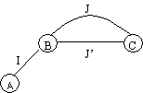
Optimal substructure
A problem exhibits optimal substructure if an optimal solution to the problem contains within it optimal solutions to subproblems. This property is a key ingredient of assessing the applicability of dynamic programming as well as greedy algorithms.

Slide 25
Greedy versus dynamic programming
They all have optimal substructure
Difference： Dynamic programming always get the optimal selection. But greedy algorithm only do the local opitimal selection
Dynamic: bottom up
Greedy: up bottom

Slide 26
Knapsack Problem
Different with 0-1 knapsack problem, the item can be part selected.
Example:
n=3，c=20，(v₁,v₂,v₃)=(25,24,15)，
(w₁,w₂,w₃)=(18,15,10)
其中的4个可行解是：
 | (x₁,x₂,x₃) | ∑w_{i} x_{i} | ∑v_{i}x_{i}
① | (1/2,1/3,1/4) | 16.5 | 24.25
② | (1,2/15,0) | 20 | 28.2
③ | (0,2/3,1) | 20 | 31
④ | (0,1,1/2) | 20 | 31.5

Slide 27
Measurement standard
Sort the items according to the descending order of value
n=3，c=20，
(v1,v2,v3)=(25,24,15)，
(w1,w2,w3)=(18,15,10)
The whole value is 28.2, not optimal solution

Slide 28
Measurement standard
Sort the items according to weight wi
n=3，c=20，
(v1,v2,v3)=(25,24,15)，
(w1,w2,w3)=(10,15, 18)
The whole value is 31, not optimal solution

Slide 29
Measurement standard
Sort the items according to v_{i}/w_{i}
n=3，c=20，
(v1,v2,v3)=(25,24,15)，
(w1,w2,w3)=(18,15, 10)
The whole value is 31.5

Slide 30
Greedy algorithm of knapsack problem
void Knapsack(int n, float M, float v[ ], float w[ ], float x[ ] )
{
Sort (n, v, w);//将各种物品按单位重量价值排序
int i;
for ( i = 1; i <= n; i ++ ) x[i] = 0;//将解向量初始化为零
float c = M; // 是背包剩余容量初始化为M
for ( i = 1;i <= n; i ++ ) {
if ( ) break;
x[ i ] = 1;
c ;
}
if ( i <= n ) ;
}
w[i] > c
- = w[ i ]
x[ i ] = c / w[ i ]

Slide 31
Time complexity
Sort algorithm needs O(nlogn)
It is not fit for 0-1knapsack problem

Slide 32
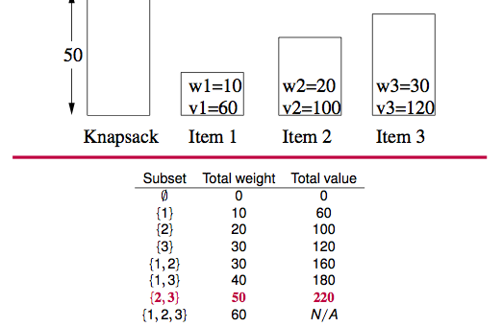
The knapsack problem

Slide 33
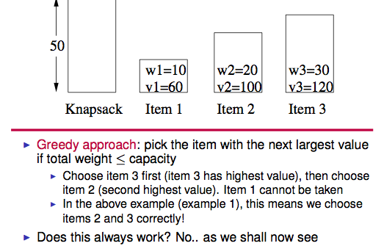
The knapsack problem

Slide 34
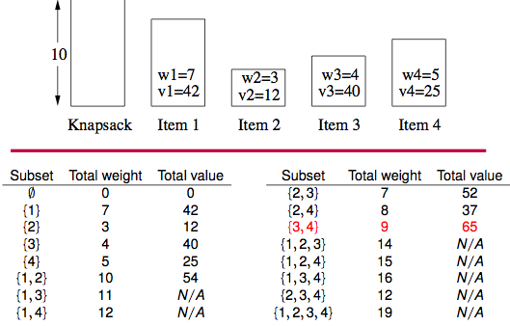
The knapsack problem

Slide 35
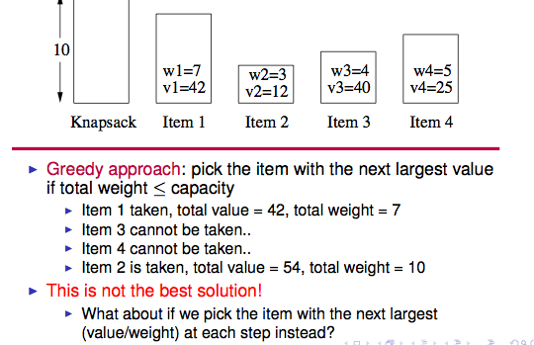
The knapsack problem

Slide 36
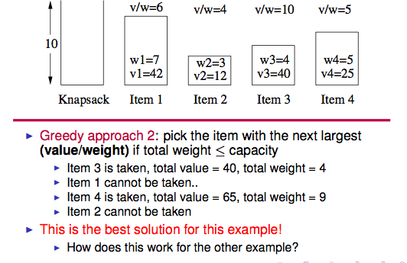
The knapsack problem

Slide 37
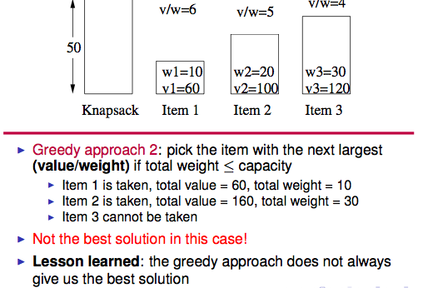
The knapsack problem

Slide 38
Optimal loading problem
Problem description:
A group of containers with weights( ) to be loaded on board a ship loading capacity of C, the volume required to load the unrestricted case, as many containers loaded on ships.
Algorithm Analysis:
Light weight, first installed by the greedy selection strategy, the optimal load can produce the optimal solution.

Slide 39
1.Greedy algorithm
采用重量最轻者先装的贪心选择策略.
template< class Type >
void Loading ( int x[ ], Type w[ ],Type c, int n)
{
int *t = new int [ n + 1];
sort ( w, t, n );
for ( int i = 1; i <= n; i ++)
x[ i ] = 0;
for( int i =1;i <= n && w[ t[ i ] ] <= c; i + + ){
x[ t[i] ] = 1;
c - = w[ t[i] ];}
}
t[i]中存储第i轻物品在原来序列中的下标

Slide 40
example
Weights are 15，10，27，18，loads of ship is 50
w[ ]={15, 10, 27, 18}
T [ ]={ 1 , 0, 3, 2}
C=50
w[T[0]]=10<c, c= c-10=40
w[T[1]]=15<c, c=c-15=25
w[T[2]]=18<c, c=c-18=7
w[T[3]]=27>c

Slide 41
Spanning Tree
Spanning Tree of a connected undirected graph G :
a subgraph of G which is a tree and contains all vertices of G.
input graph
2
2
1
1
3
3
2
2
1
2
4
4
1
3
1
3
4
3
4
4
Different Spanning Trees

Slide 42
Minimum Spanning Tree
Spanning Tree of a connected undirected graph G :
a subgraph of G that is a tree and contains all the vertices of G.
a weighted graph → spanning tree with minimum weight:
Minimum spanning tree
(weight of tree = sum of the weights of its edges).
input graph
Different Minimum Spanning Trees
2
2
2
6
6
1
1
1
1
1
1
6
3
6
3
6
6
3
2
6
6
4
2
4
4
1
1
6
1
6
3
not an MSP
6
3
6
6
4
4

Slide 43
Minimum Spanning Tree
On the previous slide, we can see three possible spanning trees (others also possible)
Note that in each case, adding another edge would introduce a cycle, meaning it would no longer be a tree
Our next question is this: how do we find a minimal spanning tree?

Slide 44
Greedy Algorithm
We shall now look at the design strategy of a greedy algorithm:
At every step, make the best move you can make
Keep going until you’re done
Advantages
Don’t need to pay much effort at each step
Usually finds a solution very quickly
The solution found is usually not bad
Possible problem
The solution found may NOT be the best one

Slide 45
Prim’s Minimum Spanning Tree Algorithm
Select an arbitrary vertex to start the tree;
while there are vertices not in the tree do
select an edge of minimum weight among all edges
between a vertex in the tree and a vertex not in the tree;
add the selected edge and its end vertex to the tree
end
U
V- U
u
v
◎Software College, NEU

Slide 46
Prim’s algorithm
Graph manipulation algorithms
Categories of vertices during finding MST.
- Tree vertices: in the tree
- Fringe vertices: adjacent to a tree vertex
- Unseen vertices: others
E
3
C
B
2
F
A
6
I
G
7
H
the tree so far
fringe vertices

Slide 47
Prim’s Minimum Spanning Tree Example
2
B
A
4
7
3
6
1
G
3
2
C
F
5
The unseen vertices adjacent
to B enter the fringe
I
4
H
6
2
8
2
E
1
D
B
4
C
2
B
A
3
G
G
3
7
A
7
F
F
The tree & fringe after
the starting vertex is selected
After selecting an edge and vertex
BG is not shown as AG is a better
choice (has lower w) to reach G

Slide 48
Prim’s Minimum Spanning Tree Example
2
B
B, G & F conn. to A through a single edge
A
4
A
B
7
3
6
7
3
Next V is the one nearest to A or B
1
G
3
2
C
G
F
5
I
H
F
B
4
2
2
A
B
A
6
2
8
A
B
A
B
4
7
4
7
3
4
7
G
E
1
D
7
3
6
G
3
C
3
C
G
G
C
F
1
F
5
F
F
I
H
I
4
H
2
E
A
B
A
B
A
B
B
7
4
7
4
A
G
G
7
G
5
3
C
5
3
C
3
2
C
G
C
F
F
F
5
F
I
H
I
4
H
I
H
I
H
6
4
6
8
2
4
6
8
E
1
D
E
D
E
D
E
D
weight=18

Slide 49
Prim’s Minimum Spanning Tree Example
2
B
Optimisation: for each vertex not in the tree, it suffices to consider
only the shortest of the edges that connect it to a tree vertex.
A
4
7
3
6
1
G
3
2
C
F
5
I
4
H
B
A
B
6
2
8
2
2
B
B
A
4
A
A
4
7
4
E
D
7
3
7
3
G
G
3
C
1
G
G
1
3
C
F
5
F
C
F
H
F
I
H
I
2
E
A
B
A
B
A
B
B
4
A
G
3
C
G
3
C
G
G
F
5
F
5
F
5
2
C
C
H
I
H
F
I
2
I
H
I
H
E
1
D
E
D
E
D
E
D
weight=18

Slide 50
Prim’s Minimum Spanning Tree Algorithm
置S={1}
贪心准则：选取满足条件i ∈S，j ∈V-S，且c[i][j]最小的边，将顶点j添加到S中
这个过程直到S=V为止
void Prim( int n, Type **c )
{
T = Ø;
S ={1};
while ( S !=V){
(i, j) = i ∈S且j ∈V- S的最小权边;
T = T U {(i, j)};
S = S U {j};
}
}

Slide 51
Prim’s Minimum Spanning Tree Algorithm
greedy algorithm
time complexity = Θ(m +n ²) = Θ(n ²)
space complexity = an extra Θ(n)
2
B
A
4
7
3
6
1
G
3
2
C
F
5
I
4
H
6
2
8
2
E
1
D

Slide 52
Kruskal’s Minimum Spanning Tree Algorithm
Kruskal’s algorithm is another greedy algorithm which finds a minimal spanning tree
The basic idea is that at each stage, it tries to add the next minimal weight edge from the graph whilst not introducing cycles, until it reaches a connected graph (which is the minimal spanning tree)
由小到大顺序选取各条边，若选某边后不形成回路，则将其保留作为树的一条边；若选某边后形成回路，则将其舍弃，

Slide 53
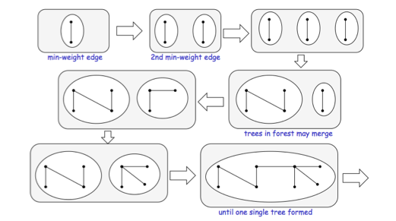
Basic idea of Kruskal’s algorithm

Slide 54
Kruskal’s Minimum Spanning Tree Algorithm
Sort the edges in increasing order of weight and put them in a list L;
count = 0;
while count <n–1 and L is not empty do
Let uv be the next edge in L;
Remove uv from L;
if uv does not introduce a cycle in T
add uv to T;
end
End.
2
DE(1)
GI (1)
AB(2)
CD(2)
CH(2)
E I (2)
AG(3)
GH(3)
BC(4)
HI (4)
F I (5)
BG(6)
EF(6)
AF(7)
DH(8)
A
B
7
3
6
4
1
G
3
2
C
F
5
I
4
H
6
2
8
2
E
1
D

Slide 55
Kruskal’s MST Example
DE(1)
GI (1)
AB(2)
CD(2)
CH(2)
E I (2)
AG(3)
GH(3)*
BC(4)*
HI (4)*
F I (5)
BG(6)^
EF(6)^
AF(7)^
DH(8)^
2
A
B
A
B
A
B
7
3
6
4
G
G
G
G
C
5
1
3
2
C
F
I
I
I
I
4
H
6
2
8
2
E
D
E
D
E
D
E
D
E
D
1
A
B
A
B
A
B
A
B
G
C
G
C
G
C
G
C
I
H
I
H
I
H
F
I
H
E
D
E
D
E
D
E
D
Terminate when all edges have been processed
weight=18

Slide 56
Kruskal’s Minimum Spanning Tree Algorithm
Sort the edges in increasing order of weight and put them in a list L;
count = 0;
while count <n–1 and L is not empty do
Let uv be the next edge in L;
Remove uv from L;
if uv does not introduce a cycle in T
add uv to T;
count = count +1
end
end.
Time complexity = Θ(m log m)

Slide 57
Shortest Path
A path from u to v is a shortest path from u to v if there is no path from u to v with lower weight. (A shortest path is not unique.)
The distance d (u,v) of two vertices u, v is the weight of a shortest path in G from u to v. If no such path exists, then we put d (u,v)=∞. We define d (u,u) = 0.
Shortest Path Problem G = (V, E, W):
- Given u and v find the shortest path from u to v
- Given u find the shortest path from u to all other vertices
- Find the shortest paths between all pairs of vertices.
Greedy Algorithm : choose an edge to a vertex that appears to be closest.

Slide 58
Dijkstra’s Shortest Path Algorithm
Find shortest paths from A to the other vertices in order of
increasing distance from A.
Like Prim’s MST algorithm, starts at one vertex (A) and “branches out” by selecting certain edges that lead to new vertices.
The tree built by this algorithm is called a shortest path tree.
Greedy Algorithm : choose an edge to a vertex that appears to be closest. In the sense “closest” is “closest to A”.
Tree / Fringe / Unseen vertices

Slide 59
Dijkstra’s Shortest Path Algorithm
Algorithm ShortestPath(L: adjacencyList, u: vertex)
Input: weighted graph G = (V,E,W); u vertex
Output: the shortest paths from u to all other vertices in G
add u to the tree as the root
d (u,u):=0
while there are vertices which are not in the tree do
among all edges xy for which x is in the tree and y is not, choose one for which d (u,x)+w (xy) is minimum;
add the vertex y and the edge xy to the tree;
d (u,y) := d (u,x) + w (xy);
end while.

Slide 60
Shortest Path Example (Paths from A)
2
B
2
B
2
B
2
B
A
A
A
A
9
5
6
4
9
5
9
5
6
4
9
5
4
G
5
5
C
G
G
C
G
C
F
1
2
F
F
F
2
5
I
4
H
d(A,B)=2
I
H
6
3
1
2
d(A,G)=5
E
D
d(A,C)=6
1
2
2
2
B
2
B
A
B
A
B
A
A
4
4
5
4
5
4
9
5
5
G
G
G
5
C
2
5
C
2
G
C
2
5
5
C
F
1
2
F
1
F
1
F
I
H
H
I
H
I
H
2
I
2
2
3
2
3
1
1
D
E
D
E
1
D
E
1
D
d(A,I)=7
d(A,D)=8
d(A,F)=8
d(A,H)=9
d(A,E)=9

Slide 61
Dijkstra’s Shortest Path Algorithm
Correctness of Dijkstra’s Shortest path algorithm
At each stage, for each node x in the current tree, d (u,x) is the shortest distance from u to x.
Note also that the vertices are added to the tree in increasing order of their distance to u.
The shortest path is given by the path in the tree.
Time complexity of Dijkstra’s Shortest path algorithm
Straightforward implementation O(n ³)
Using more efficient data structures Θ(n ²)

Slide 62
Floyd-Warshall’s Algorithm
Problems
Given a graph G, for all pairs of edges u, v, in the graph:
Decide if there is a path from u to v.
Compute the shortest path from u to v.
Determine how many different paths from u to v exist.
Floyd-Warshall algorithm – to be described later (under dynamic programming)

Slide 63
Multi-machine scheduling problem

Slide 64
There are n jobs{1,2,…, n}. They are processed by m heterogeneous machines. The processing time required for job i is t_{i}
The multi-machine scheduling problem requires a job scheduling scheme, so that the given n jobs are processed by m machines in the shortest possible time.
It is stipulated that each job can be processed on any machine, but it is not allowed to interrupt processing before it is completed. Jobs cannot be split into smaller sub-jobs.

Slide 65
Multi-machine scheduling problem
A greedy selection strategy : the longest processing time priority
A good approximation algorithm for solving multi-machine scheduling problems.
when , just distribute time period [0,t_{i} ] of machine i to job I
when First, the n jobs are sorted according to their required processing decending. The job is then assigned to the idle handler in this order.

Slide 66
class JobNode{
friend void Greedy( JobNode *, int, int );
friend void main( void );
public:
operator int ( ) const{ return time; }
private:
int ID, time;
};
class Machine Node{
friend void Greedy( JobNode *, int, int );
public:
operator int( ) const{ return avail; }
private:
int ID, avail;
};
ID为作业的编号
time为该作业需要的时间
ID为机器的编号
avail记录该机器何时空闲

Slide 67
template<class Type>
void Greedy(Type a[],int n,int m)
{
if( n <= m ){
cout<<“为每个作业分配一台机器.”<<endl;
return;}
Sort( a, n );
MinHeap < MachineNode > H( m );
MachineNode x;
for( int i = 1; i <= m; i ++ ){
x. avail = 0;
x. ID = i;
H. Insert( x );
}
取到堆中最早空闲的机器来处理第i个任务，把它从堆中删去，使得下一个最早空闲的机器在堆顶
如果作业数小于机器数，给每个作业分配一台机器
建立一个小堆，堆中每个结点存有一台机器的状态
for( int i = n; i >= 1; i - -){
H.DeleteMin( x );
cout<<“将机器”<<x.ID<<“从”
<<x.avail<<“到”<<(x.avail+a[i].time)
<<“的时间段分配给作业”<<a[i].ID<<endl;
x.avail + = a[ i ]. time;
H. Insert( x );
}
}
初始化每台机器，开始都空闲，所以avail （记录该机器何时空闲）都为0，并把该机器插入堆中
将第i个任务占用的机器的空闲时间加上该任务的时间，并插入堆中

Slide 68
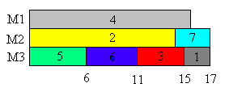
There are 7 independent jobs {1,2,3,4,5,6,7} and 3 machines M1，M2 and M3.The process time of the jobs are {2,14,4,16,6,5,3}。The schedule accroding to greedy algorithm is as followed. The total time is 17

Slide 69
Complexity
when , the complexity is O(1).
when , sorting complexity is O(nlogn). Initial a heap- O(m). DeleteMin and Insert operation of heap - O(nlogm)
O(nlogn+nlogm)=O(nlogn)

